Slide 1
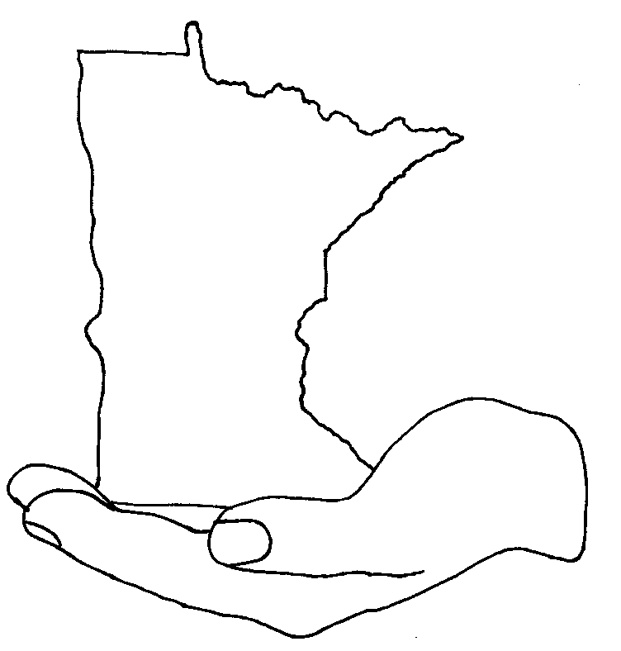
REGULATED MATERIALS/WASTE HANDLING FOR GREATER MN
Environmental Investigation Unit
Office of Environmental Stewardship
2019

Slide 2
GENERAL
Place wastes in sturdy containers with no dents or rust.
Keep areas around containers clear and uncluttered.
Keep waste container lids and bungs closed at all times except when adding wastes.

Slide 3
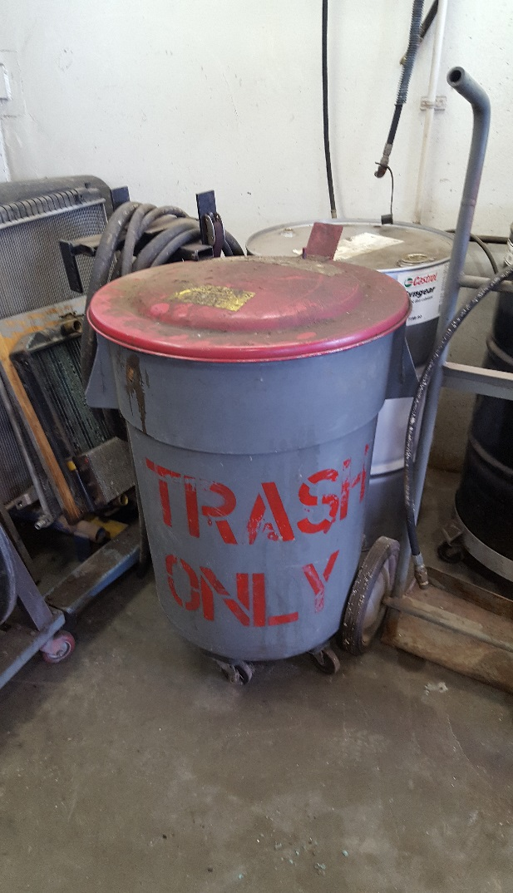
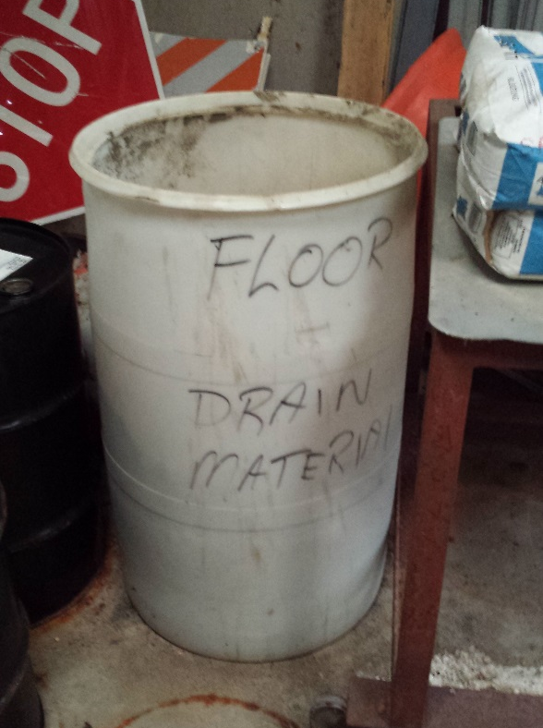
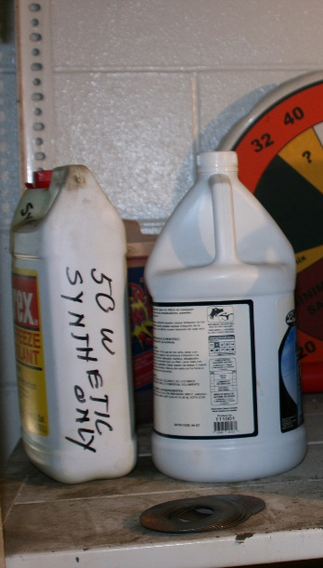
LABEL ALL CONTAINERS
All containers need to be labeled of its contents.

Slide 4
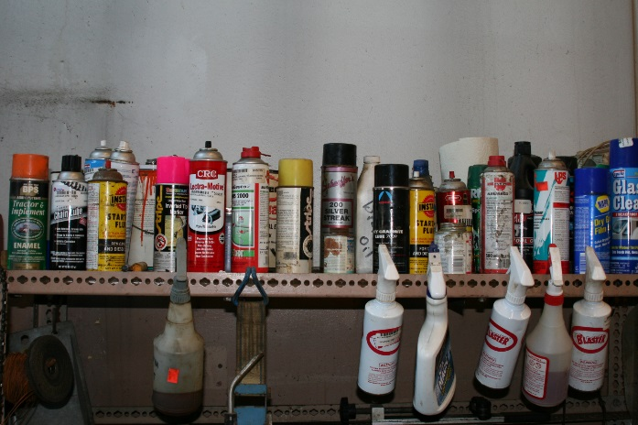
When Ordering Products
Use MnDOT Inventory!
  Use Approved Products List
  Ask these questions:
    Is this the least hazardous option?
    Is the product ordered just enough to do the job?

Slide 5

WHEN MANAGING A WASTE
Use Safety and Inventory personnel
  As an information source
  Waste consolidation
  Disposal
  Approved end sites
  Record keeping

Slide 6
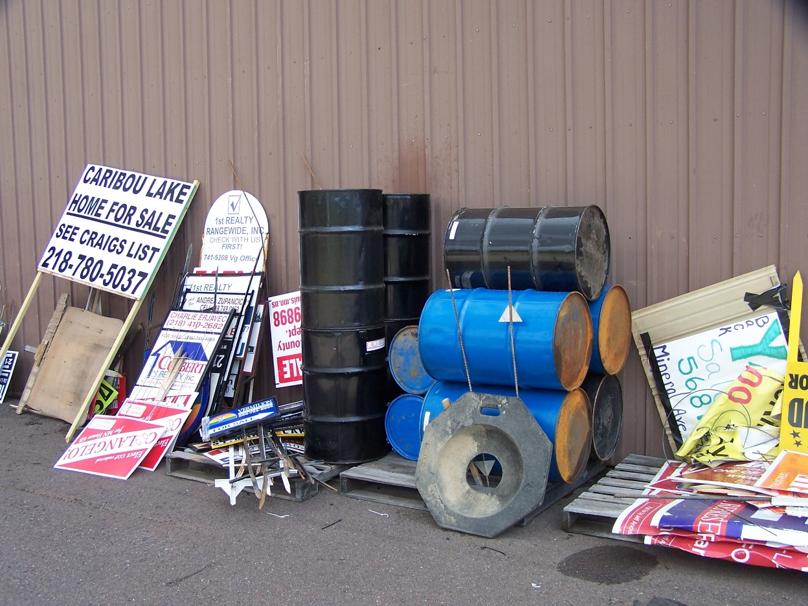
EMPTY DRUMS
Store on side.
At a designated location.

Slide 7
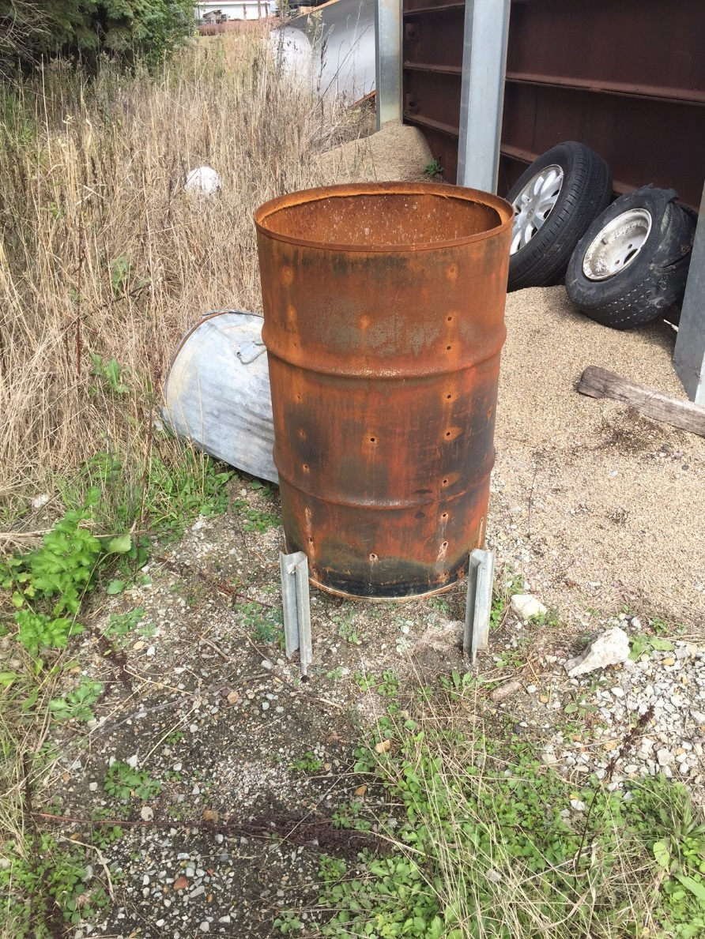
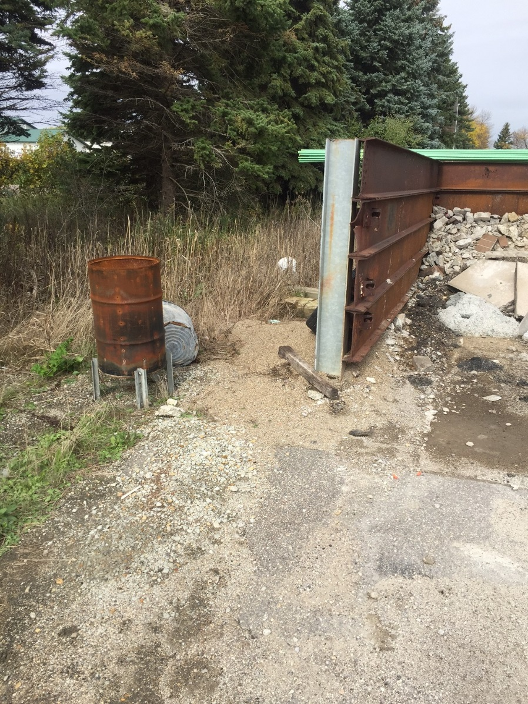
No Trash Burning

Slide 8
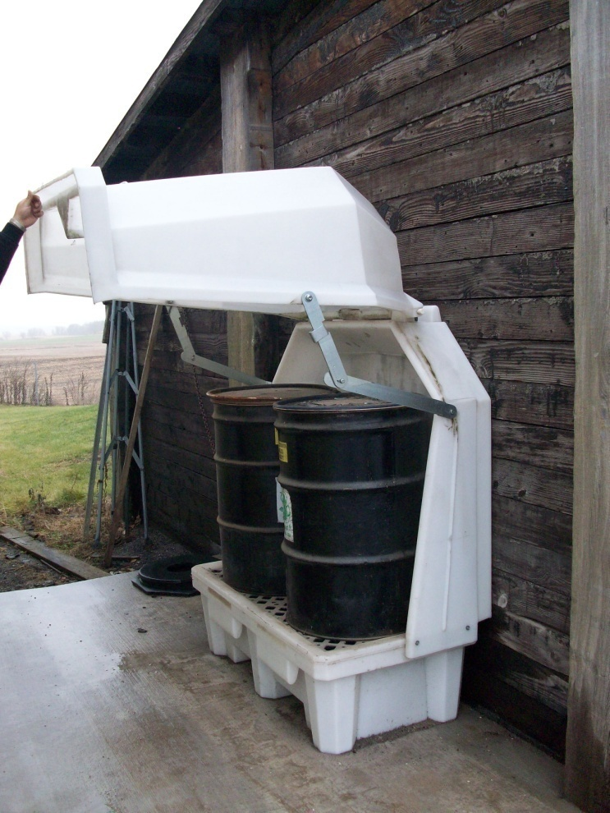
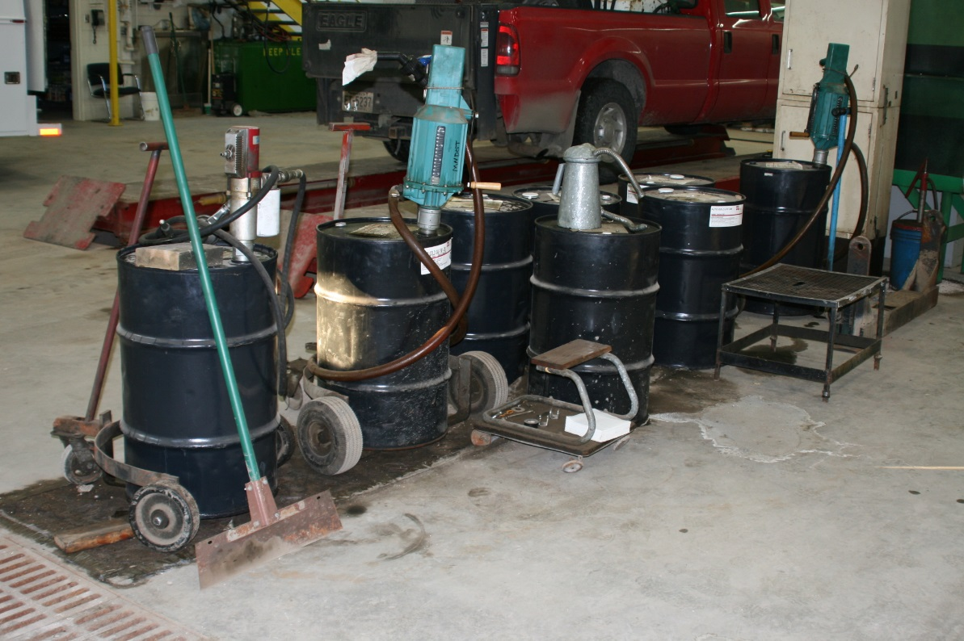
Store Containers Holding Products or Waste Out of the Outside Elements

Slide 9
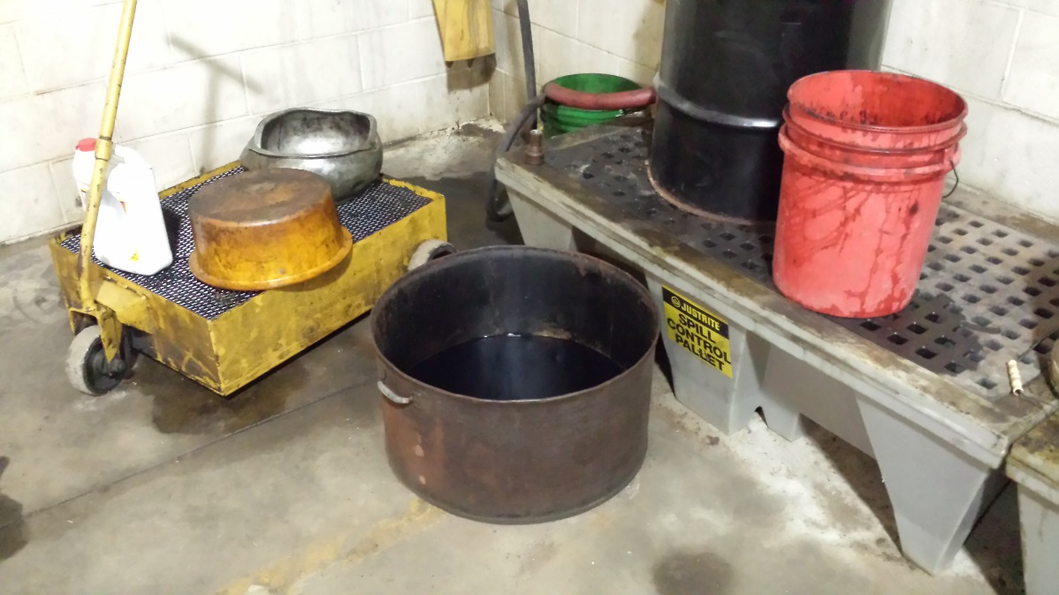
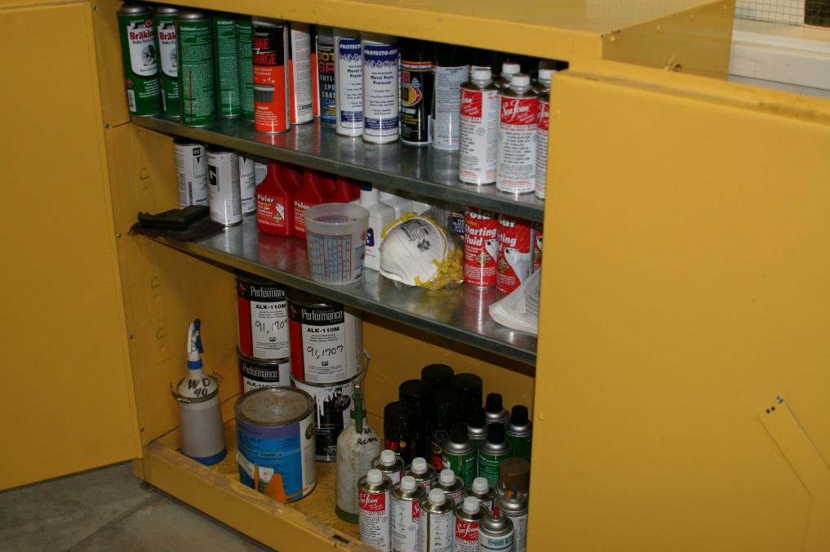
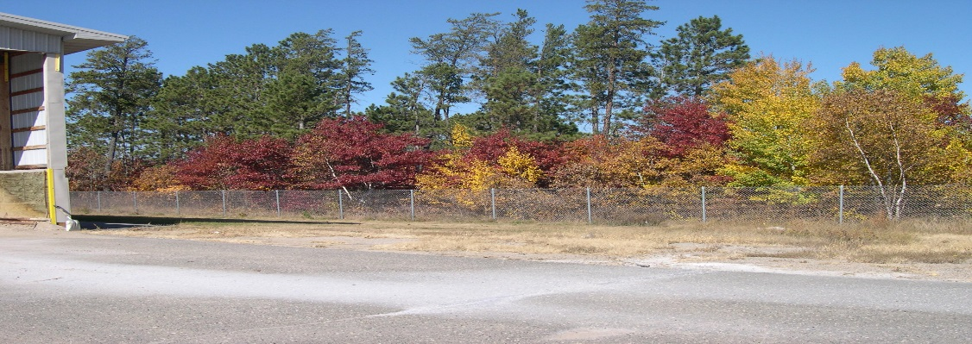
Housekeeping
Flammable Storage Cabinets
Keep common area for used Oil Storage and Change out clean/swept
Fence Lines

Slide 10

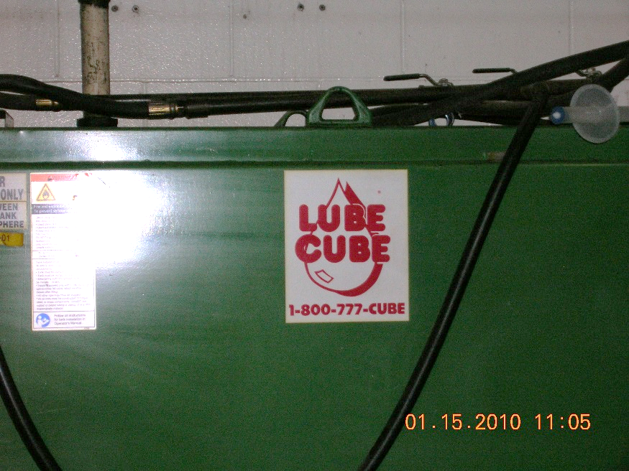
USED OIL
Used oil can be burned on site for heat.
Can be transported by MnDOT personnel
  if >55 gallon container, contact Safety.

Slide 11
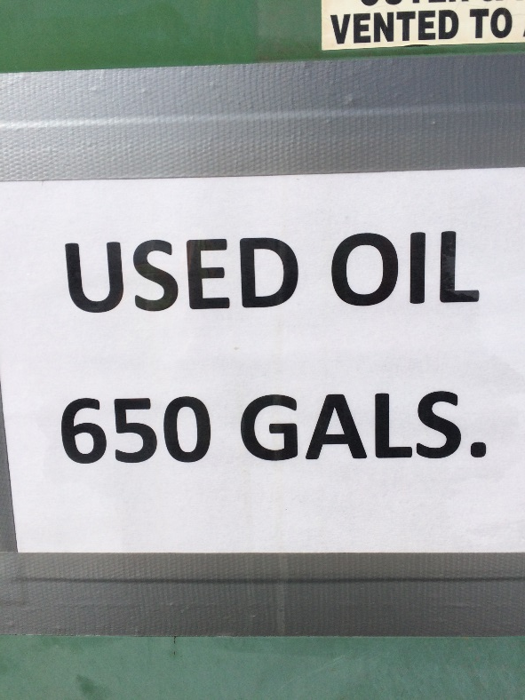

USED OIL
Includes: motor oil, transmission fluid, lubricating oil, hydraulic oil, power steering fluid, brake fluid, and gear oil.
Does not include: solvents/thinners, gasoline, degreasers, or any other waste.

Slide 12
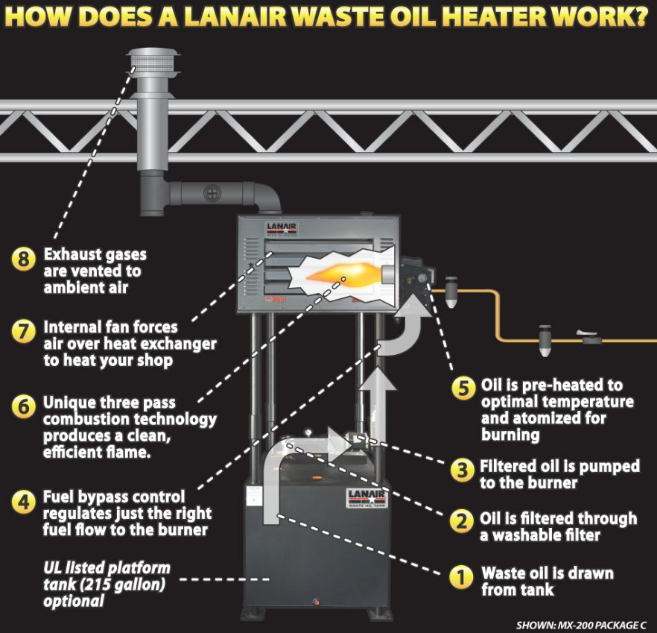
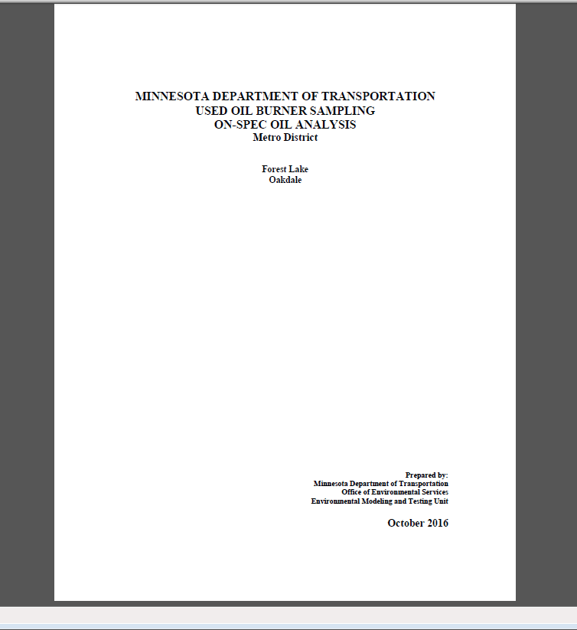
USED OIL BURNERS
Must have On-Spec used oil analysis.

Slide 13

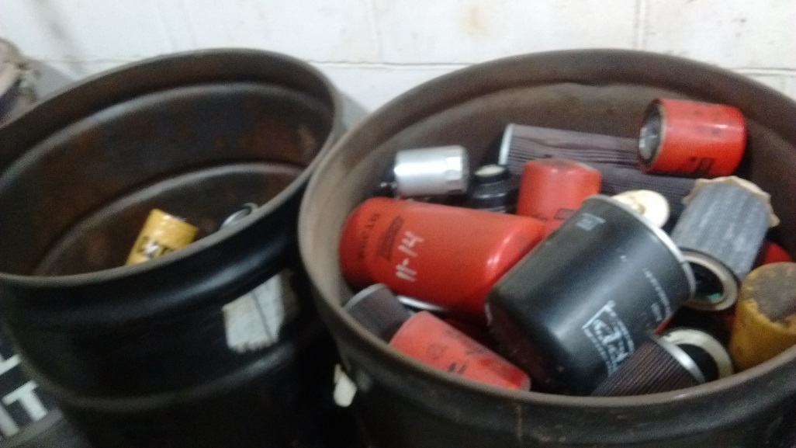
USED OIL FILTERS
Drain a minimum of 24 hours.
Place into “used oil filter” drum AND Cover.

Slide 14
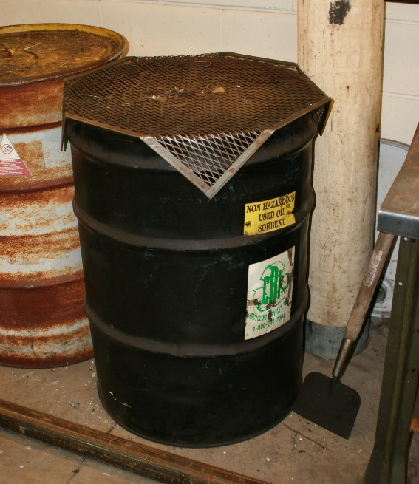
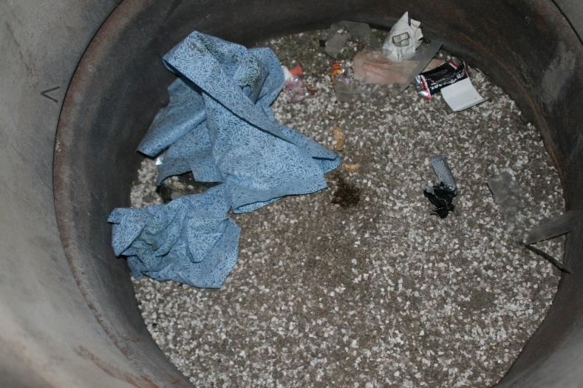
USED OIL SORBENTS
Re-use sorbents material as much as possible.
Recycle sorbents; do not throw in trash.
Sorbents soaked with liquids other than used oil (solvents, etc.) should be kept in a separate container.

Slide 15
DO NOT MIX!
Used Oil Sorbents
  Oil rags have the option of laundry service
Oil Filters
Store In Separate containers…

Slide 16
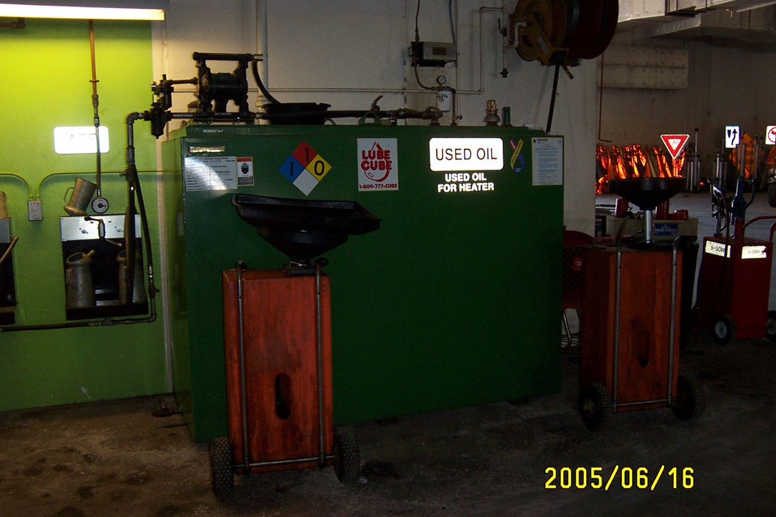
CLEANING USED OIL LUBE CUBES
Use Approved Contractors to clean.
OSI, Minnesota Petroleum/MnBlue, Etc.

Slide 17

USED ANTIFREEZE
Do not put into storm sewer or septic tank.
Use a MnDOT approved contractor
Can discharge to a WWTP (Wastewater Treatment Plant) with permission from the WWTP.
  Must keep records showing amount of waste antifreeze generated.

Slide 18
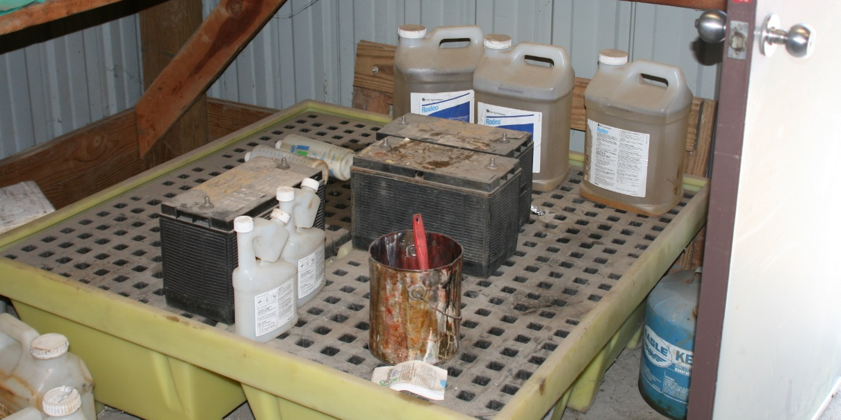
USED LEAD-ACID BATTERIES
Send to HQ for proper management
Must be stored on acid resistant surface/curbing, with no floor drains.
  plastic tub
  Asphalt
  Rubber
  concrete with an acid
  resistant coating.

Slide 19
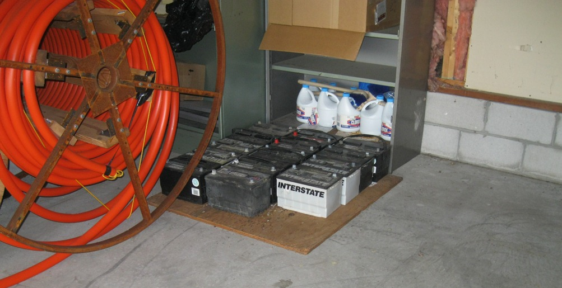
What’s Wrong???

Slide 20
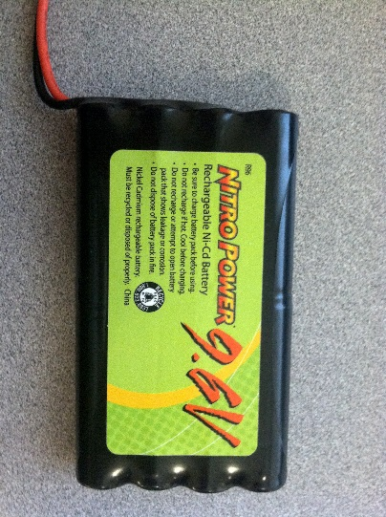
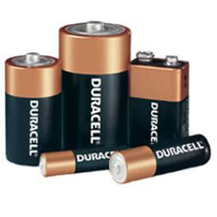
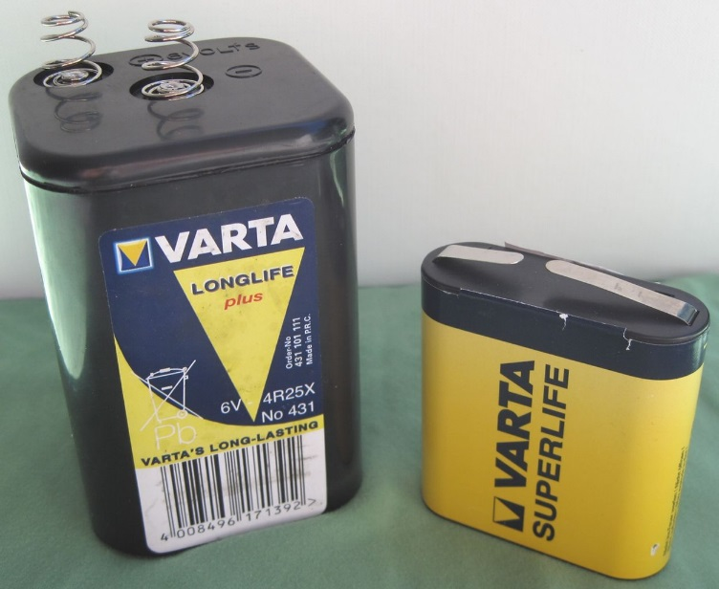
USED DRY CELL BATTERIES
Alkaline and 6V lithium batteries can be thrown in the trash.
Other batteries must be collected in a designated storage location
Tape ends with electrical/duct tape or store in baggies separately.

Slide 21
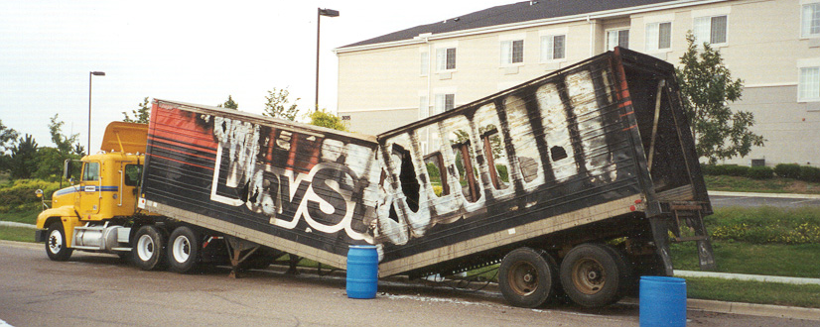
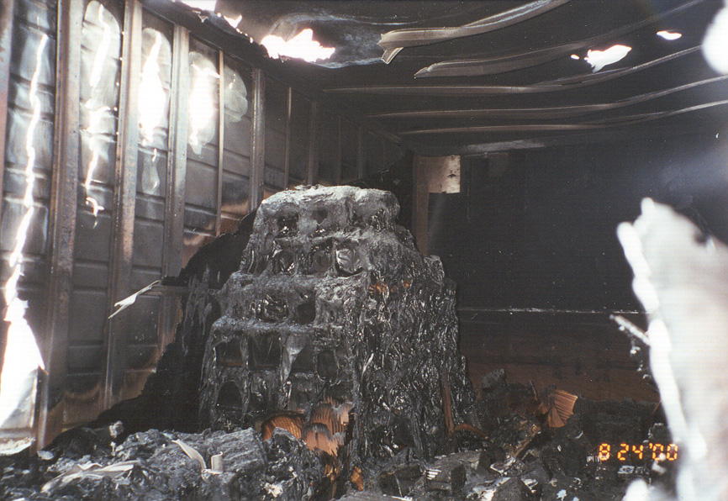
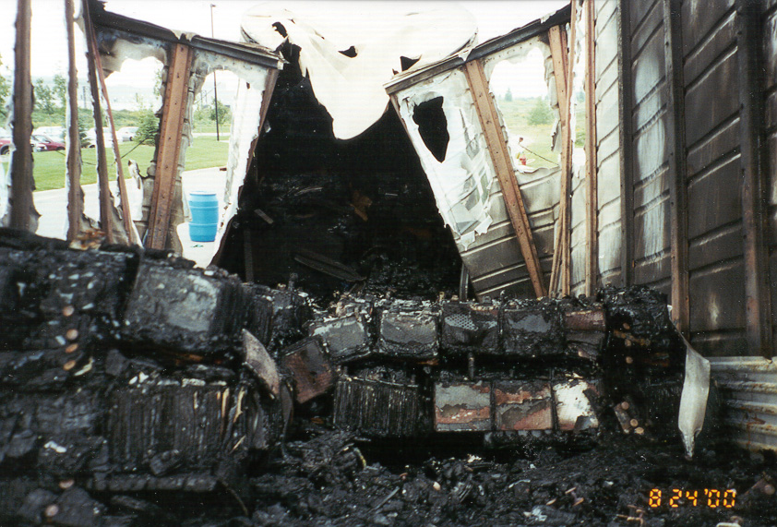
Battery Fire

Slide 22
PARTS WASHER WASTE
MnDOT has found it cost effective to filter and reuse.
If liquid is determined to be a waste
Place in empty, clean drum.
Contact District Safety Administrator for proper management.
Keep lids and bungs closed, except when adding.

Slide 23
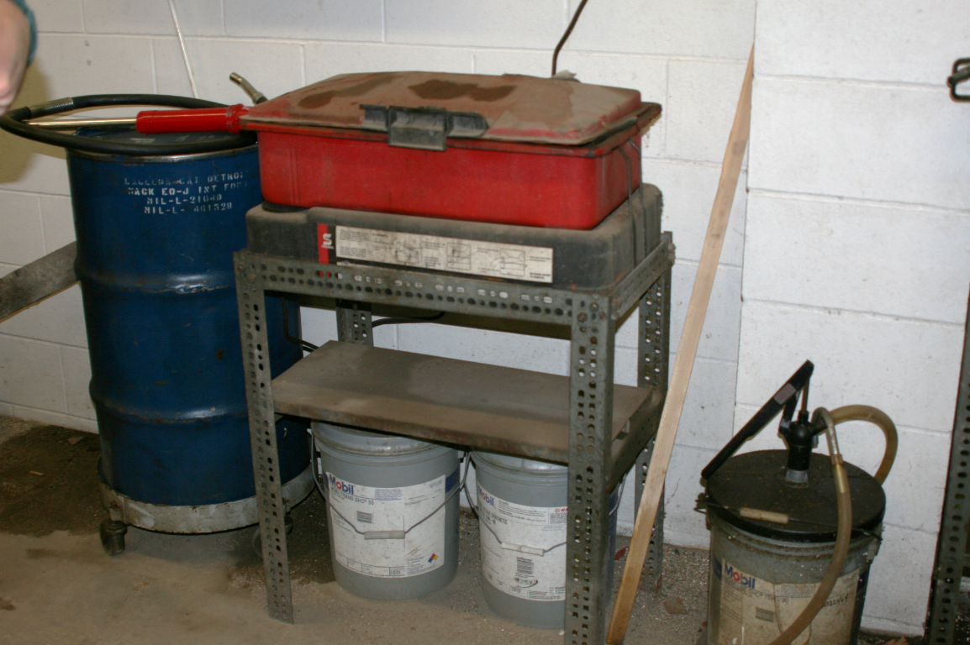
WASTE PARTS WASHER FILTERS
Dispose with burnable used oil sorbents if fiber.
Dispose with used oil filters if metal.

Slide 24
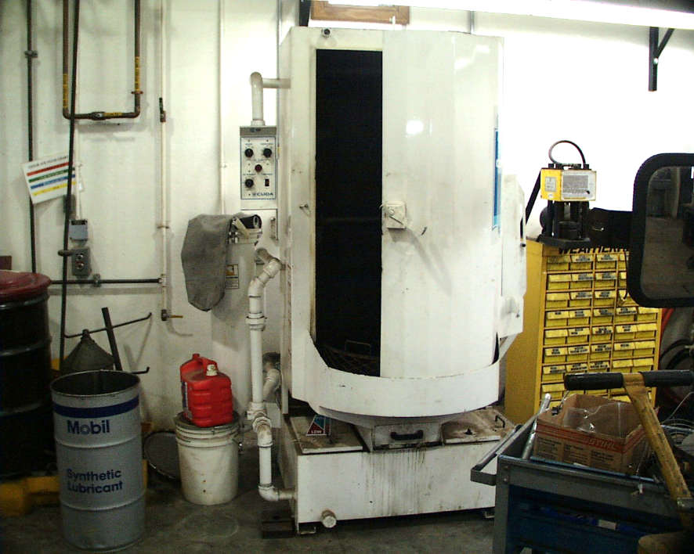

AQUEOUS PARTS WASHER OIL SKIMMERS
Mix with used oil.

Slide 25
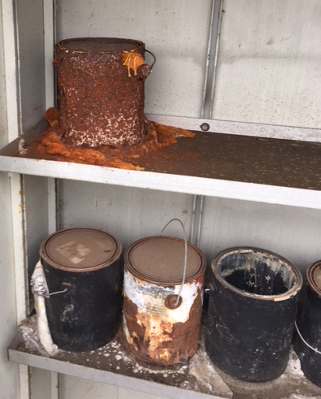
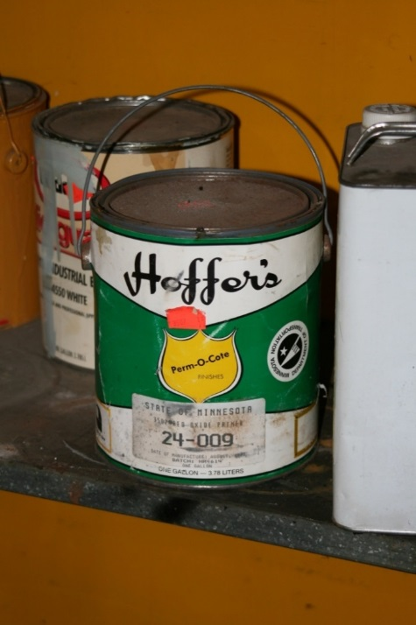
OLD PAINTS, SOLVENTS, AEROSOL PRODUCTS
If over 10 years old, time to get rid of…
Beyond shelf life

Slide 26
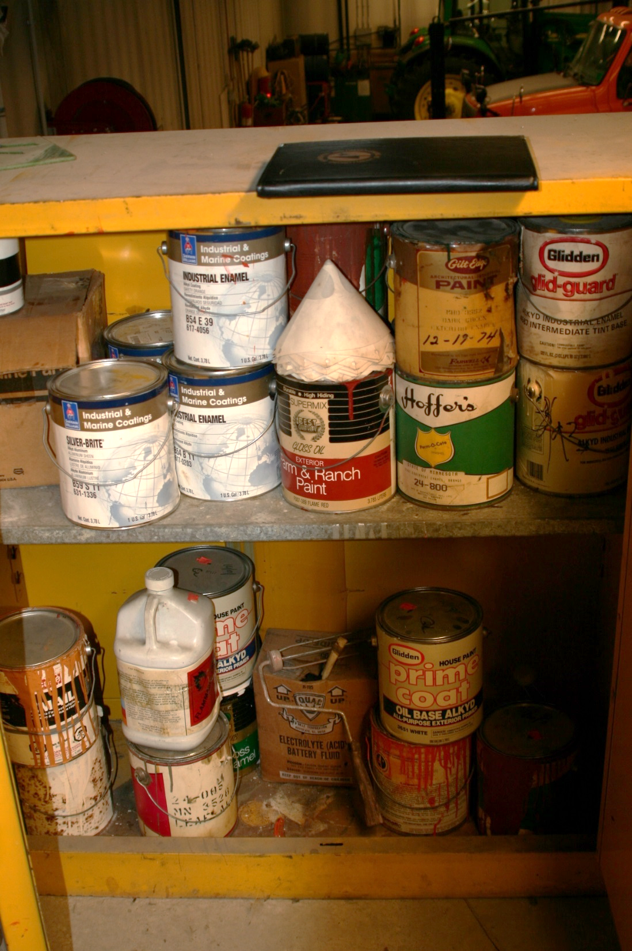

PAINT WASTE
MnDOT has found it most cost effective to use disposable paint brushes.
Recycling paint is free; contact your District Safety person for recycling paint.

Slide 27
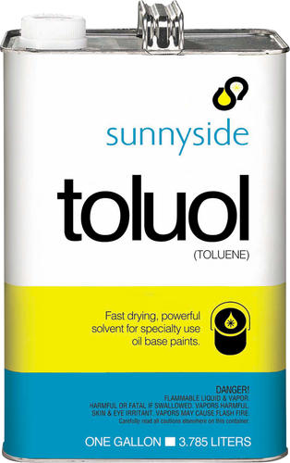
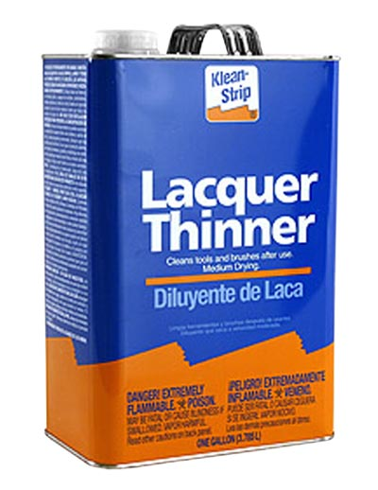
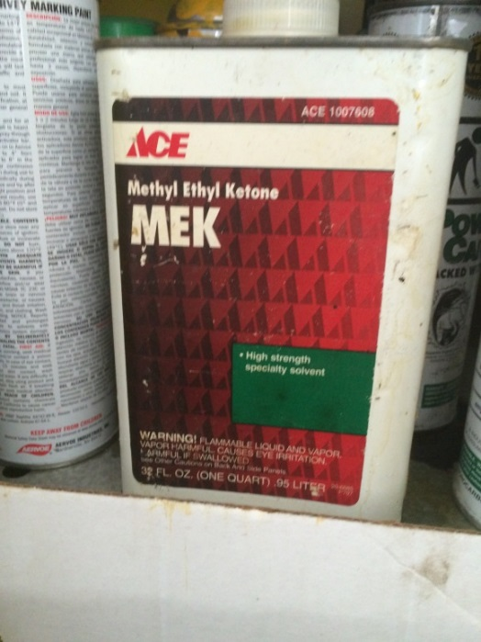
WASTE PAINT SOLVENT
Use products through inventory
MPCA’s “F” list
Lacquer Thinner
  Watch out…
Don’t Use!
If you must use, must handle all rags as HW!!

Slide 28
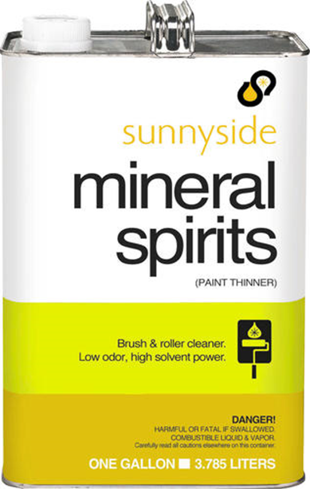
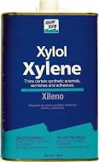
Solvents
Preferred: Mineral Spirits
Acceptable: Xylene and Acetone

Slide 29
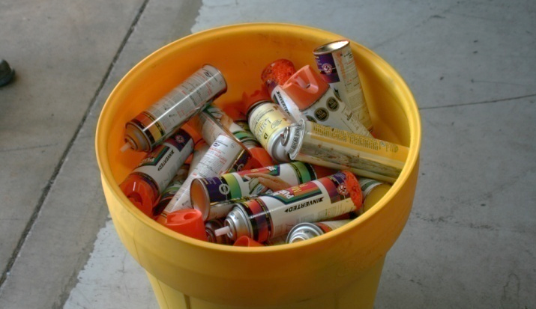
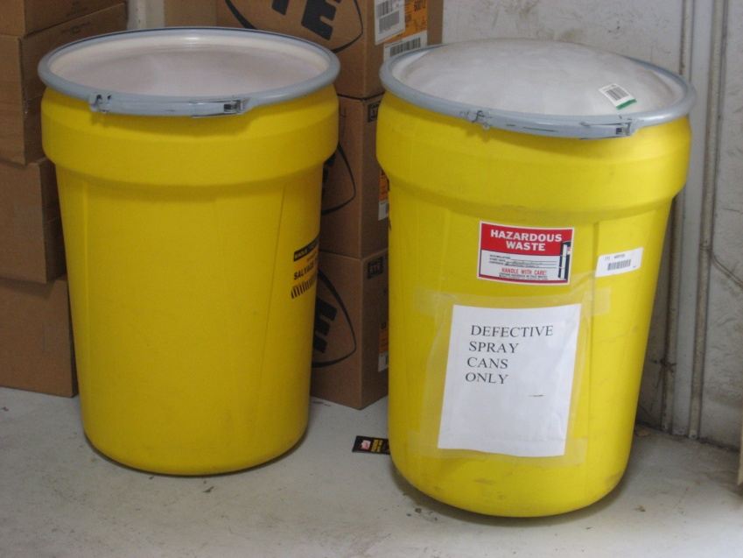
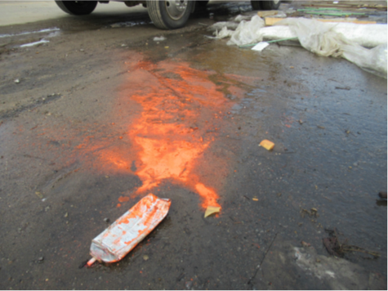
WASTE AEROSOL CANS
Empties can go in the trash.
Manage partially full unusable cans as hazardous waste.
Remove Stems/Nozzles
No picks or hammer claws.

Slide 30
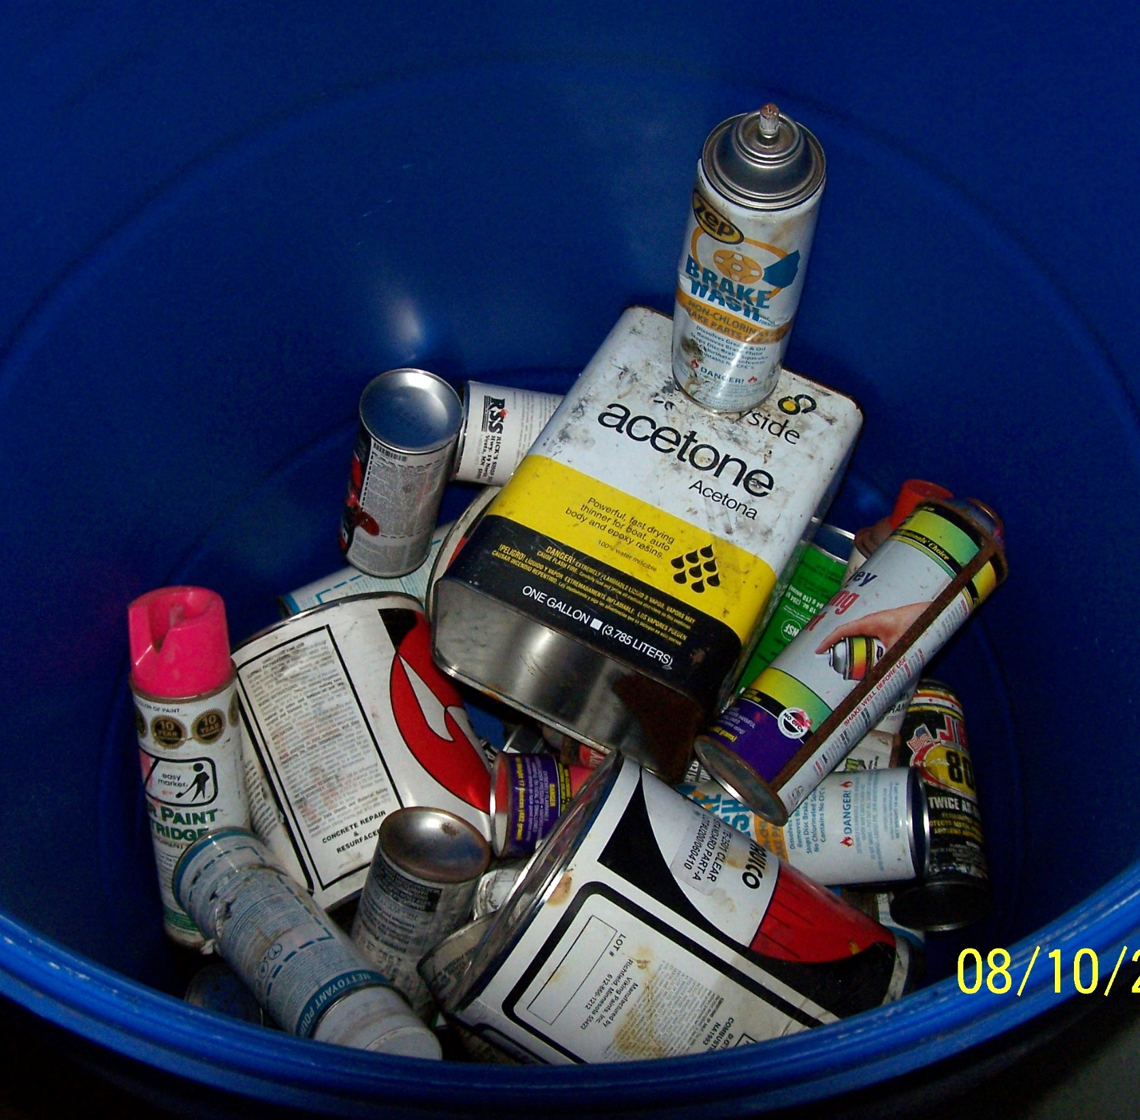
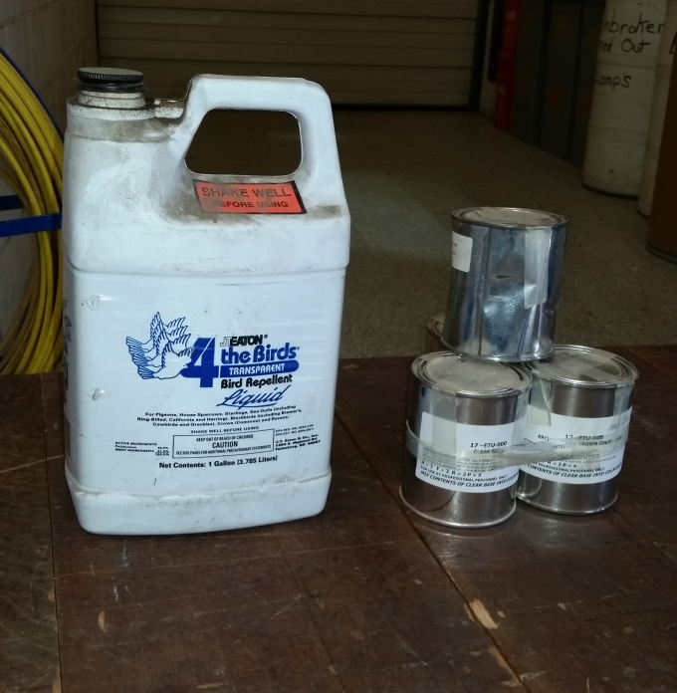
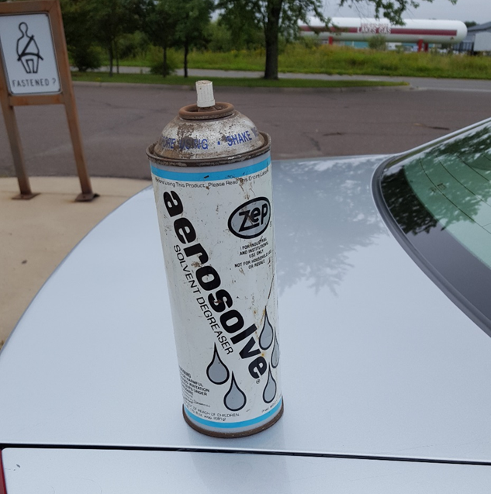
Waste Aerosols
Don’t mix with other wastes! (below picture found in drum)
Also, watch for F-listed wastes in aerosols!

Slide 31
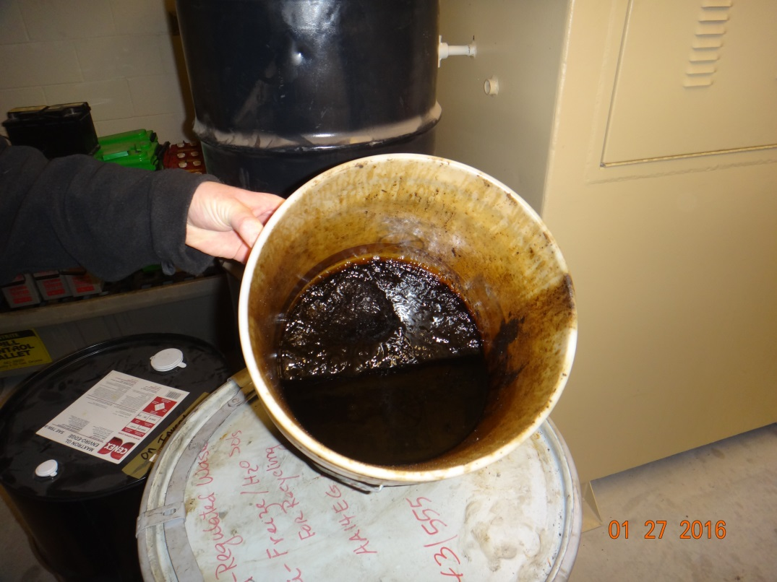
Asphalt Sludge
Cannot Dispose on asphalt piles.
Must containerize
  Non hazardous
  Label as Asphalt Sludge
  Small amounts may be added to
  used oil sorbents

Slide 32
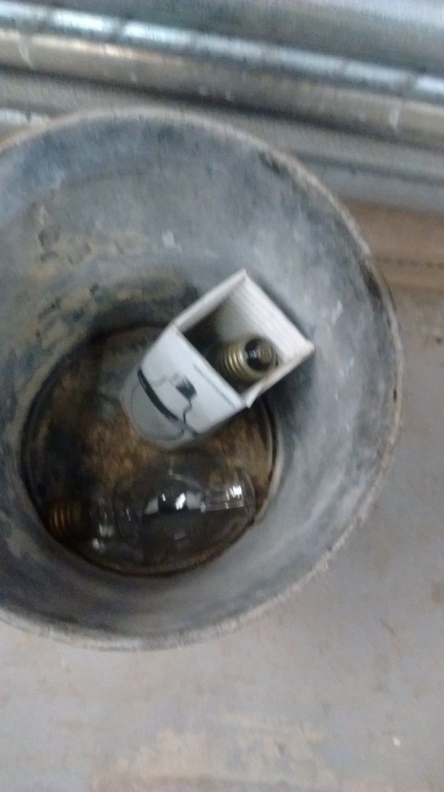
USED FLUORESCENT BULBS
Do not crush or break.
Do not tape together.
Store in original boxes or other boxes of similar size.
If lamps break, store in sealed, labeled container.
Label containers “Waste Lamps” or “Used Lamps“ and Date.
Store in a designated location.

Slide 33
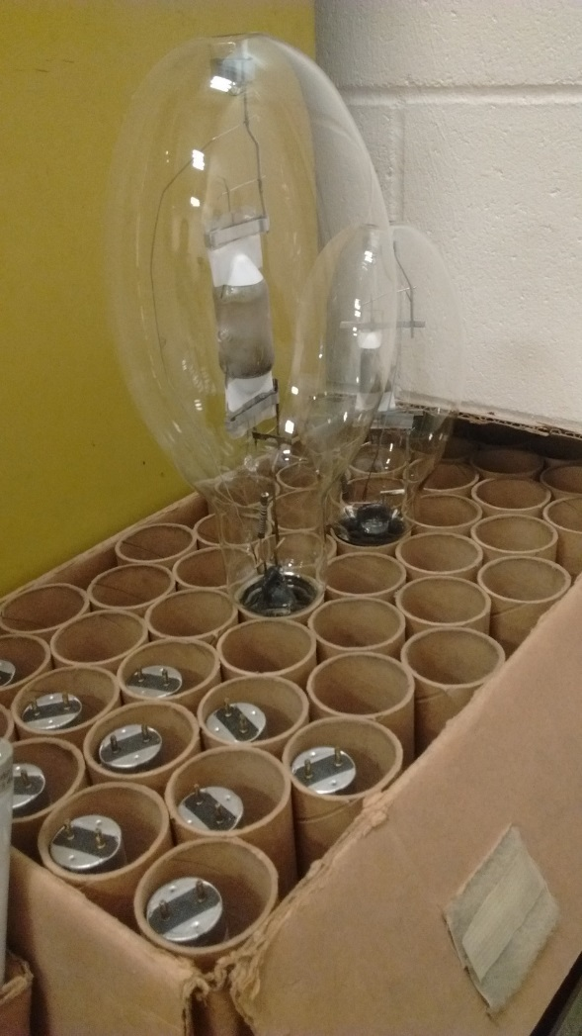
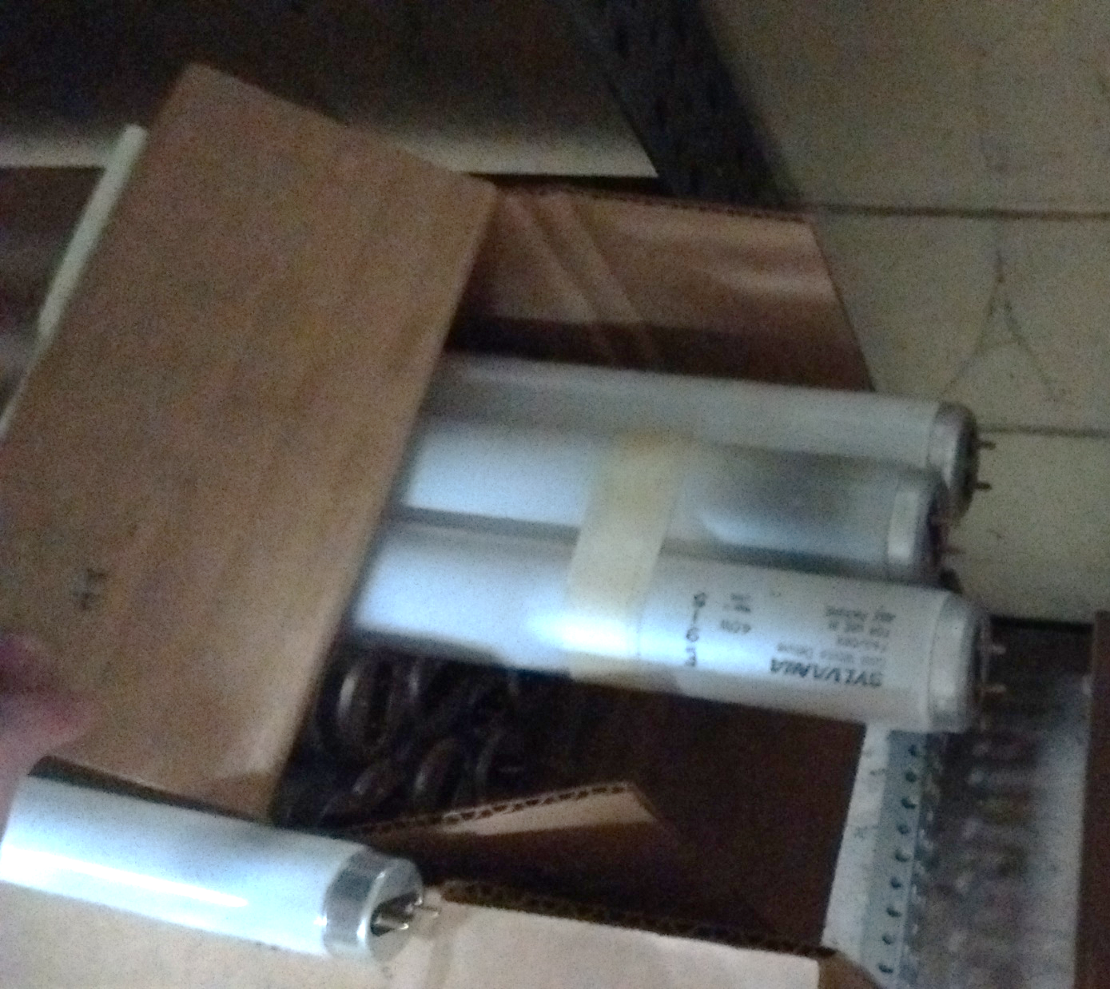
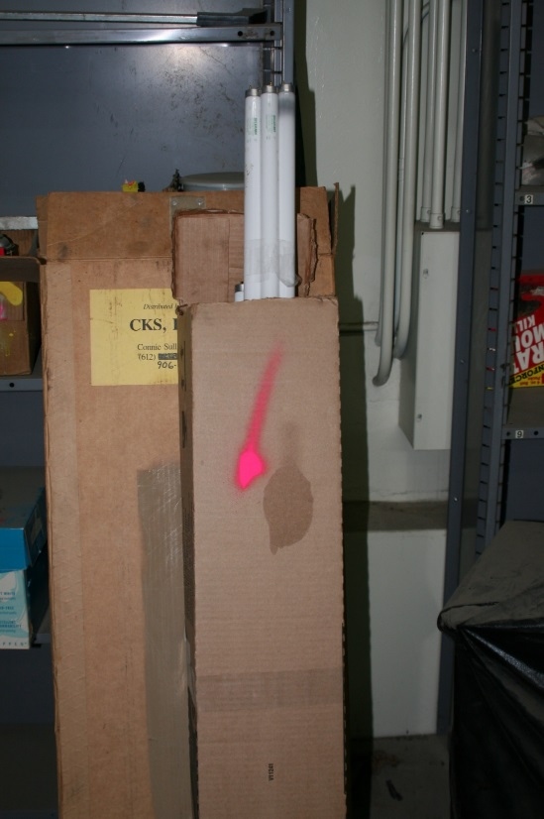

Fluorescent Bulb No-No’s

Slide 34


WASTE BALLASTS/CAPACITORS
Treat as hazardous unless it states “No PCB’s”.
Label must be visible.

Slide 35



SPILL CONTROL
Absorbent
Spec Approved Container
Non-Spark Producing (aluminum) Shovel

Slide 36

FLAMMABLE / SEDIMENT WASTE TRAPS
Top - Oil layer - Dispose with Oil Sorbents
Middle - Water layer - Down the Drain
Bottom - Sand layer – MPCA permitted Sanitary/Industrial Landfill

Slide 37


Good Housekeeping of
Sediment Traps
Clean spills immediately
  Prior to going down drain
Keep containers closed
Keep floors clean
  Sweep
  Drip pans
No dumping liquid wastes
  Solvents, oils, etc.
Clean sediment traps periodically

Slide 38



Flammable Trap/Waste Oil
Sorbent pads are hydrophobic
Sits on the top oily layer
Dispose with oil sorbents

Slide 39
WASTE TRAP SAND
Industrial Waste
Stored away from outside elements.
  In building
  Covered
Dispose of in a MPCA permitted sanitary landfill or MPCA permitted industrial landfill.
  Not a demolition landfill.
Another option is manage at an asphalt plant.

Slide 40


Waste Trap Sand
No Land Application
  Salt is the main concern; will not evaporate or biodegrade. It will remain and migrate to groundwater and surface water.
No Sand Piles
  Placement on a sand pile is considered land application.

Slide 41

Septage Waste
No land application, unless approved by Neile Reider.

Slide 42

STREET SWEEPINGS/GRIT CHAMBERS
¾” Screen
Does not pass through, dispose at a MPCA permitted sanitary landfill.
Does pass through,
  Sub-base, Fill, Concrete
  IF, 100 ft from water/drainage, 3 ft above groundwater, 10 ft above fractured bedrock

Slide 43

STREET SWEEPINGS/GRIT CHAMBERS
OR
Dispose of at an MPCA permitted sanitary landfill or MPCA permitted industrial landfill

Slide 44


Problems with Hiring Contractor to Clean
(waste traps, holding tanks, septage)
Internal Audit Findings:
Unknown to where sediment sand is going
Contractor is land farming sediment sand and septage

Slide 45

Removal Contracts
(waste traps, holding tanks, septage)
Specify
  End sites
  End site documentation
    Proof of disposal
Follow the MnDOT guidance document!

Slide 46


TREATED WOOD WASTE
Disposal at MPCA permitted sanitary or industrial landfill
  Keep documentation on file (eDOCS).

Slide 47
TREATED WOOD WASTE
Can
Reuse in original form or use in secondary applications such as fence posts, landscaping, or other projects.
Cannot
Chip and reuse (landscaping).
Burn in brush pile.
Bury.

Slide 48

Cabinet Style Abrasive Blasters
Must sample and laboratory analysis prior to disposal. (Harold B.)

Slide 49

Waste Tires
Store in a designated storage area.
Inventory center will make arrangements with the vendor on contract for the pick up.

Slide 50


WASTE ELECTRONICS
Computer parts, TVs, etc.
Store out of the elements
Notify Inventory
  Palletized
  MnDOT approved recycling facility.
  State Surplus Program
Road Finds…
  DO NOT THROW IN TRASH!

Slide 51


Herbicide Storage
Secondary containment

Slide 52


Waste Lead Solder
Containerize
Label container
  Hazardous Waste
  Waste solder

Slide 53



STAINS ON SAND PILE OR GROUND
Should not be disposed of in or on sand piles or ground…
  Sloppy practices…

Slide 54



Salt Storage - Poor

Slide 55



Salt Storage - Good

Slide 56


SALT NOT COVERED
Includes Winter Sand

Slide 57



Salt Release

Slide 58



Culverts
Black Coating
AB Culverts
  Asbestos Bonded Culverts

Slide 59


Recycling Office Materials
All truck stations need to recycle office material.
  Paper
  Containers
  Plastics

Slide 60

SHIPPING PAPERS REQUIRED
When shipping regulated waste from the TS to the HQ, documentation is required
  VSQG consolidation program
  Available on website
    Ship To
    Ship From
    Waste
    Quantity
    Date
    One copy to truck station. One copy to HQ’s

Slide 61

Very Small Quantity Generator (VSQG) Consolidation Program
MPCA state program
Must Follow Simple Guidelines
Transport Regulated Waste to HQ
Shipping Paper
Simple & Cost Effective
Privilege

Slide 62
VSQG CONSOLIDATION PROGRAM BENEFITS
Get out of using:
Licensed Hazardous Waste Transporter
Hazardous Waste Manifest
Stop Charge
Storage

Slide 63

Road Kill
MnDOT Urban Challenge

Slide 64



Is it a tasty meal?

Slide 65




Or Work Around It?

Slide 66

Or maybe it takes care of itself…..

Slide 67


Other Options
Leave on Right-of-Way ditch
Compost
Landfill
Game farm food

Slide 68


Leave on Right-of-Way
Ditch
Pull further off roadway
  No more than ¼ mile
Place on the ditch back slope.
When feasible, cover the carcass with wood chips.

Slide 69



Compost
Follow Dept. of Agriculture publication, “Composting Animal Mortalities”

Slide 70


Game Farm Food

Slide 71

Questions?

